Slide 1
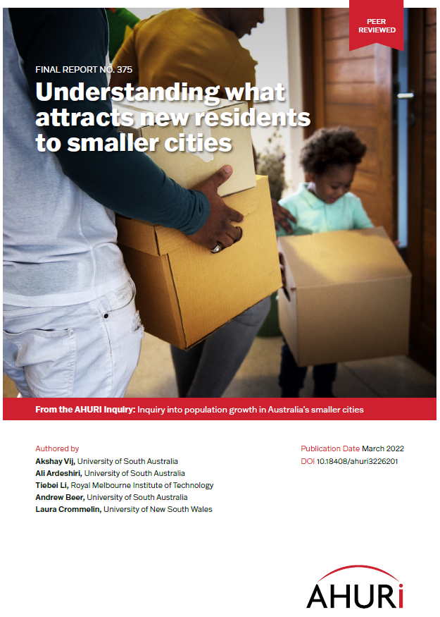
Preferences for Regional Settlement Post-Pandemic in Australia
CMVI Seminars
8 April 2022
Ali Ardeshiri
Research Fellow,
University of South Australia
Ali.Ardeshiri@unisa.edu.au
This study was funded by the Australian Housing and Urban Research Initiative (AHURI)

Slide 2
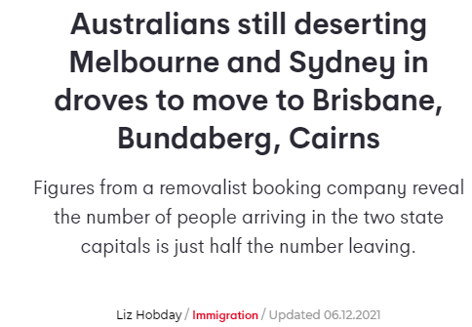
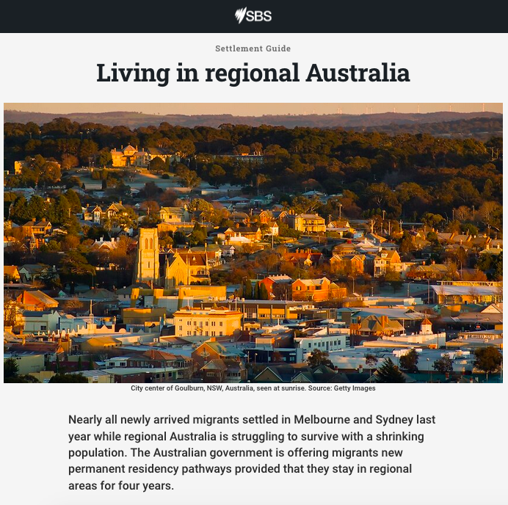
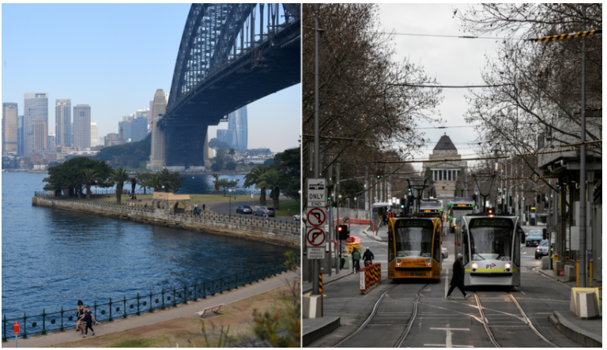
Source: https://7news.com.au/news/immigration/sydney-melbourne-exodus-not-over-yet-c-4819385
Source: https://www.sbs.com.au/language/english/living-in-regional-australia

Slide 3
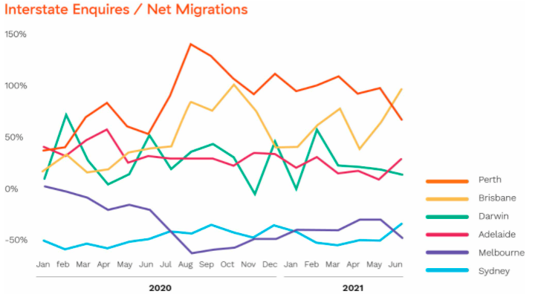
Source: https://www.muval.com.au/blog/moving-trends-australia
Notes:
Melbourne Lockdown 1 dates
31st March 2020 to Tuesday 12th May 2020
28th May 2021 to Thursday 10th June 2021

Slide 4
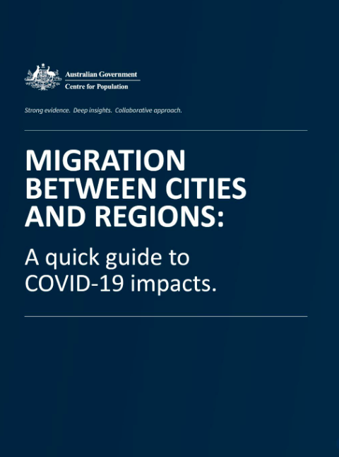
“Our central projection scenario sees a net shift in migration away from capital cities in favour of regional areas in 2020-21, before gradually returning towards the long-run average.
“Underscoring the uncertainty surrounding this topic, surveyed experts were split on the impact of COVID-19. Approximately half expect it to have no impact on migration patterns between cities and regions, with the other half expecting a slight shift in favour of migration from capital cities to regional areas.”
Source: https://population.gov.au/docs/the-impacts-of-covid-on-migration-between-cities-and-regions.pdf
Notes:
Australian Government, centre for population have released some projection scenarios which shows Australians are moving away from capital cities in regional cities as well. However, they have emphasised that the are uncertain about this topic. Half experts have said there would be no impact on migration other have a different opinion with everything that is happening around remote working, lockdowns, exploring the balance between family and work factors

Slide 5
Research objectives
Examine key drivers of migration flows and settlement patterns across Australia; and
Identify key barriers to and opportunities for greater population decentralisation.
Notes:
The study commenced in 2020 and in early stages of the pandemic. And the focus of the study was at a high level to understand drivers and migration pattern, etc.
Going through the pandemic and with everything happening with lockdowns, case number, remote working the study become twice as important however we were still in throws of the pandemic as all of this was playing out. Although the study offers insight on future migration patterns, it did not explicitly test all the different ways which the pandemic is likely to inform. Which I will return back to this latter in my presentation.

Slide 6
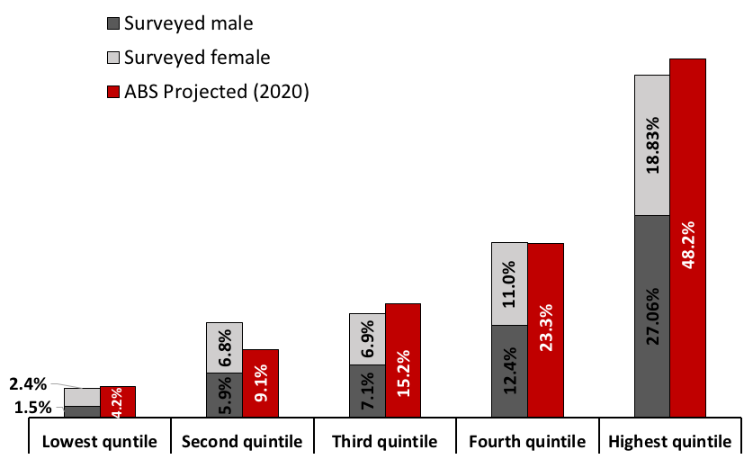
Data
Nationwide online survey of 3,012 demographically and geographically representative Australians administered in February 2021.

Slide 7
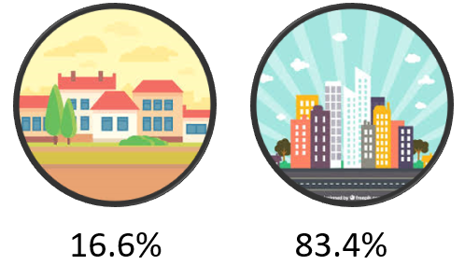
Descriptive analysis
Respondents key demographics based on their current city of residence size
Notes:
In our sample we had more female household living in mid-sized cities.
We have a higher proportion of Young adults (up until 54 years) living in large sized cities. Whereas the proportion of aged household in mid-sized cities are higher.
In terms of family structure, in our sample couple family with children and group households are higher in large cities where as couple family with no children and single person household proportion in mid sized city are higher.
In terms of household income as you can see the distribution of respondents living in large city with different income categories are leaning towards the high end of income spectrum whereas in mid-sized cities this is leaning toward the low end of income spectrum.

Slide 8
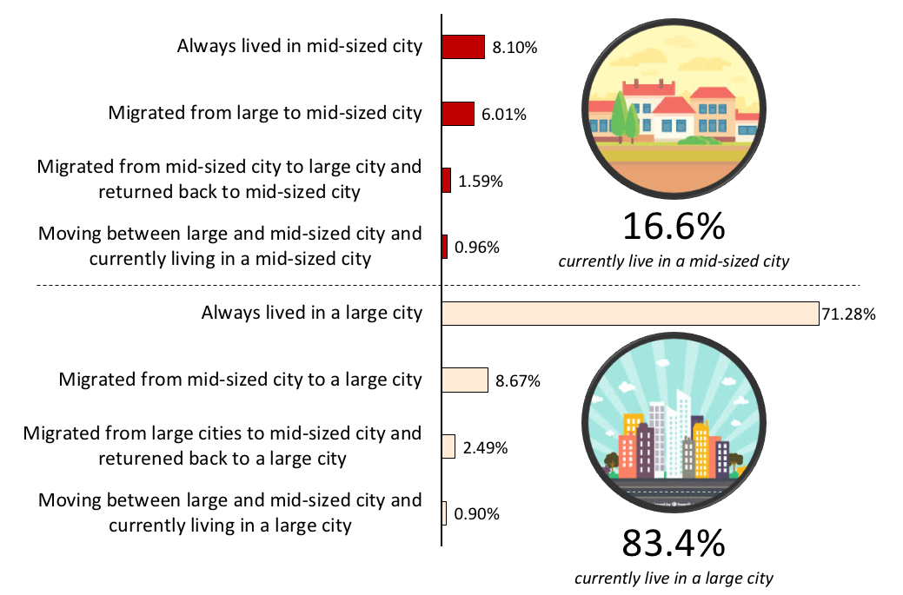
Descriptive analysis
Migration patterns as a function of current city of residence

Slide 9
Descriptive analysis
 | Total sample | Lived in large cities | Lived in mid-sized cities
Mean | 18.9 years | 20.9 years | 12.90 years
Median | 13 years | 16 years | 8 years
Respondents length of stay in each Australian city

Slide 10
Reason for move | Full sample | Currently living in a mid-sized city (16.6%) |  |  |  |  | Currently living in a large city (83.4%)
 |  | Always lived in mid-sized cities | Migrated from large to mid-sized cities | Migrated from mid-sized cities to large cities and returned back to mid-sized cities |  | Moving between large and mid-sized cities (currently living in a mid-sized city) | Always lived in a large city | Migrated from mid-sized cities to large cities | Migrated from large cities to mid-sized cities and returened to a large city |  | Moving between large and mid-cities and currently living in a large city
 |  |  |  | Reason for move to large city | Reason for return to mid-sized city |  |  |  | Reason for move to mid-sized city | Reason for return to large city
Employment and industry related issues | 27.3% | 22.4% | 23.2% | 31.3% | 31.3% | 38.0% | 17.3% | 29.1% | 42.7% | 29.3% | 37.6%
Being close to family | 21.2% | 32.5% | 23.2% | 8.3% | 18.8% | 21.5% | 31.1% | 18.8% | 16.0% | 17.3% | 14.0%
Place of birth | 10.9% | 8.4% | 20.4% | 10.4% | 6.3% | 6.3% | 15.0% | 21.8% | 5.3% | 22.7% | 6.5%
Better quality of life | 8.9% | 10.3% | 7.2% | 4.2% | 8.3% | 8.3% | 11.2% | 1.1% | 4.0% | 8.0% | 4.8%
Education | 8.0% | 5.2% | 8.3% | 18.8% | 10.4% | 3.9% | 6.7% | 13.8% | 9.3% | 8.0% | 5.4%
More affordable housing | 5.1% | 5.7% | 7.2% | 8.3% | 2.1% | 5.9% | 3.2% | 2.3% | 5.3% | 2.7% | 2.7%
Attractive environment | 3.7% | 3.2% | 2.8% | 2.1% | 4.2% | 2.9% | 3.0% | 1.5% | 2.7% | 2.7% | 7.0%
Higher income | 2.1% | 1.5% | 0.6% | 2.1% | 2.1% | 0.0% | 1.6% | 1.9% | 1.3% | 1.3% | 2.7%
Better prospects to raise children(s) | 1.6% | 1.5% | 0.6% | 4.2% | 2.1% | 1.5% | 1.8% | 1.1% | 1.3% | 0.0% | 1.1%
Better services (e.g. healthcare, banking, retail, etc.) | 1.3% | 1.2% | 0.6% | 0.0% | 0.0% | 0.5% | 1.7% | 0.4% | 2.7% | 1.3% | 2.7%
Health related reasons | 1.2% | 0.0% | 0.6% | 0.0% | 2.1% | 0.0% | 0.6% | 0.8% | 1.3% | 0.0% | 2.7%
Live in community with similar backgrounds | 1.0% | 1.5% | 1.1% | 0.0% | 0.0% | 1.5% | 0.5% | 0.0% | 0.0% | 1.3% | 1.6%
Greater sense of community and belonging | 1.0% | 1.2% | 0.0% | 0.0% | 2.1% | 1.0% | 1.1% | 0.8% | 0.0% | 0.0% | 2.2%
Amenities and entertainment facilities | 0.8% | 0.2% | 0.6% | 0.0% | 0.0% | 1.5% | 0.8% | 0.8% | 0.0% | 0.0% | 2.7%
Reasons for settlement in different cities, as a function of migration histories

Slide 11
Descriptive analysis
The important city characteristics when deciding a city to live
Notes:
Up until now I have been feeding you some information related to respondents migration patterns and history. In this an the next couple of slides I will talk about respondents perception of different urban centres.
Respondents where given a series of Likert scale questions and in this slide I am showing you the results of respondents to serios of question related the important city characteristics when deciding a city to live. This is regardless of the sized of the city.

Slide 12
Descriptive analysis
Reasons for not wanting to leave the present city of residence
Notes:
Here are respondents answers to reasons for not wanting to leave the present city of residence.
The message her is very important and clear! If you take comfort and locational benefit away from the residents. People are very likely to start considering other options. … dependencies are not strong preventers.

Slide 13
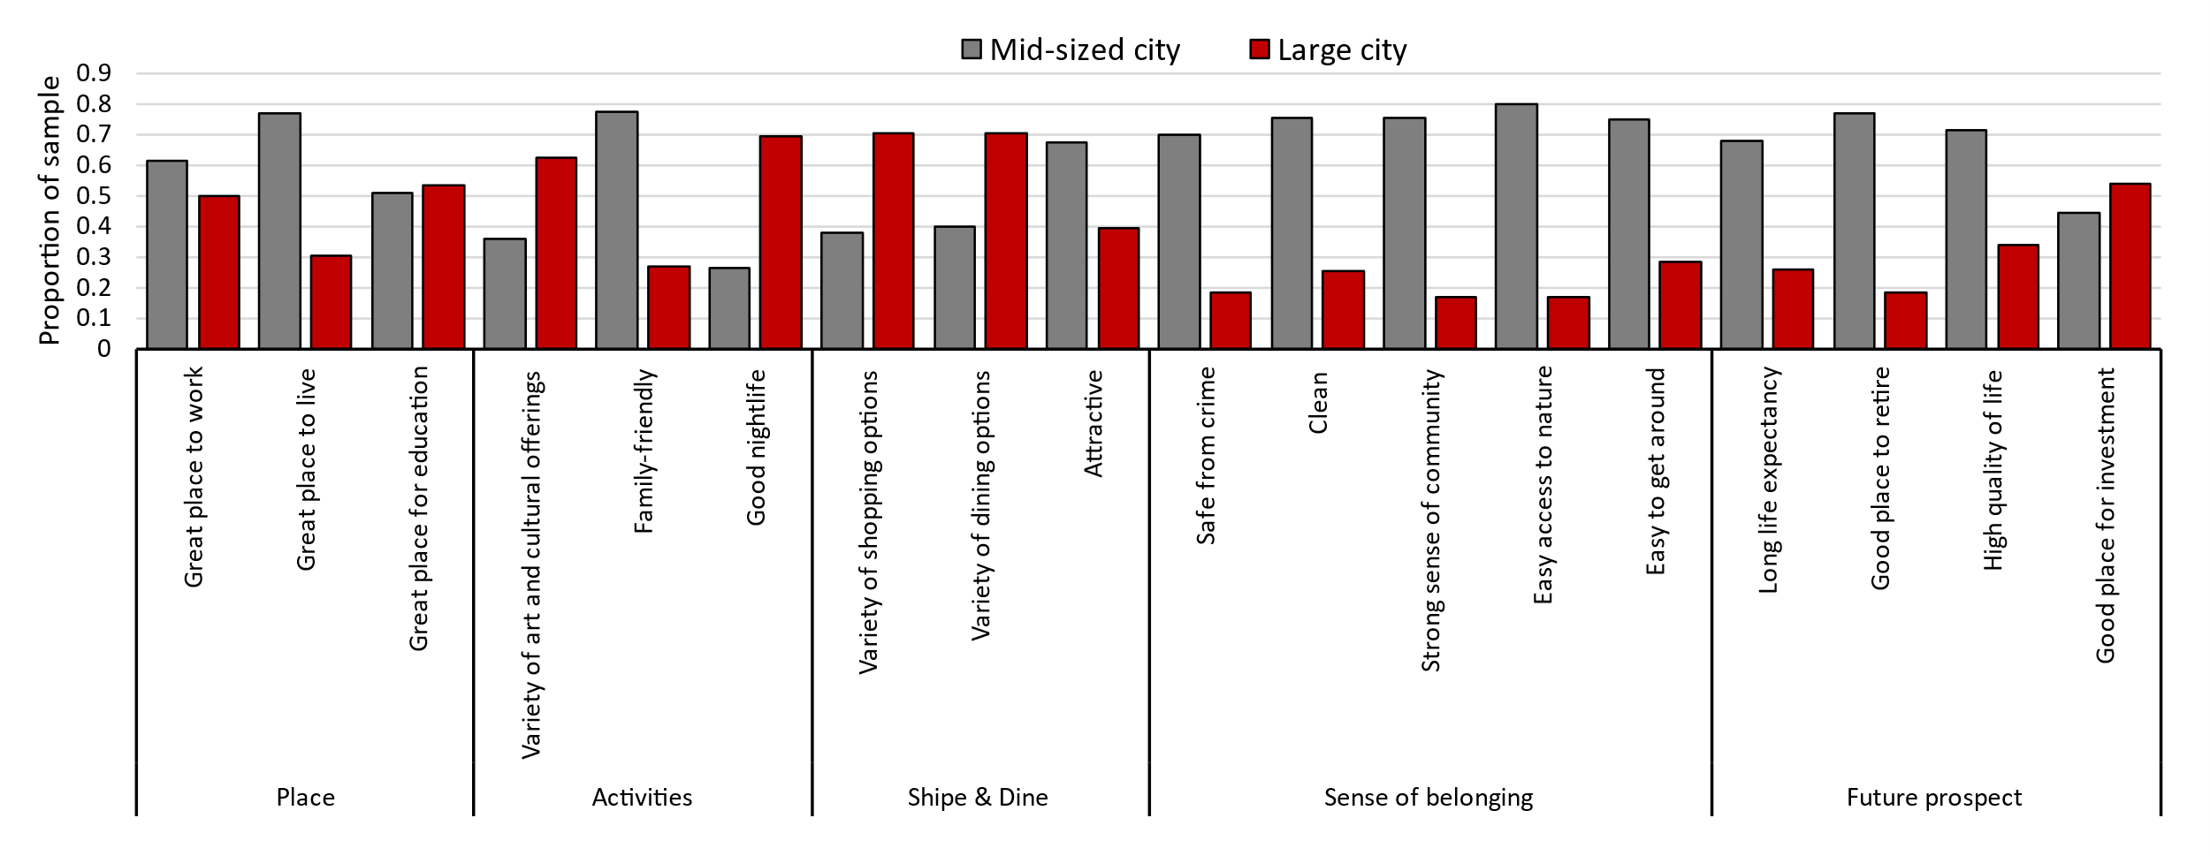
Descriptive analysis
The characteristic which describes a mid-sized and large city
Notes:
18 different characteristics were found from the literature and grouped in 5 categories to describe a mid-sized and a large size city.

Slide 14
Descriptive analysis
The characteristic which describes a mid-sized and large city
Notes:
Mid-sized cities are doing better in 12 out of the 18 characteristics!

Slide 15
Descriptive analysis
The characteristic which describes a mid-sized and large city
Notes:
Large cities are outperforming only on 6 characteristics. ….. The scales are not always to one side.
Prior to the pandemic it was all about the triumph of large cities pioneered by the work of Edward Glazer dominant the thinking in the literature. Cities and neighbourhoods planning were based on the new urbanist framework with ideas of such as creating high-dense mixed-used 24-hour cities and transit-oriented urban developments. But with COVID things have become very uncertain. I think it is very exciting and fun time to work on urban and regional development research.

Slide 16
Descriptive analysis
Notes:
People living in mid-sized cities are more likely to remain. People who live in large cities are likely and open to moving

Slide 17
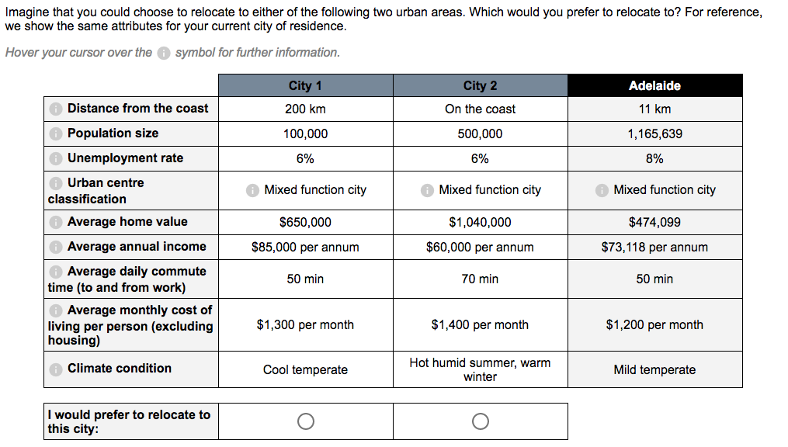
Example scenario from the stated preference experiment
Notes:
I am going to talk about one last section of our survey which is what we do a lot in our studies. This is developing and designing hypothetical scenarios as close as possible to a real life case and ask people to make decisions to understand how people make trade-offs. Here is an example.

Slide 18
# | Attribute | Range of values
1 | Distance to coast | on the coast; 37.5 km, 75km, 200km, 600km
2 | Population size: mid-sized cities | 5k; 10k; 25k; 50k; 75k; 100k
 | Population size: large cities | 250k; 500k; 750k; 1m; 1.5m; 2m; 2.5m; 5m
3 | Average annual income per person | $55k, $60k, $65k, $70k, $75k, $85k, $90k, $100k
4 | Unemployment rate | 3%, 5%, 7%, 9%, 11%, 13%, 15%
5 | Urban centre classification | industry city; service city; connected city; coastal lifestyle city; mixed function centre; agricultural city
6 | Average home sales value | $240k, $400k, $560k, $650k, $720k, $880k, $1.04m, $1.2m
7 | Average daily commute time (minutes) | 20, 30, 40, 50, 60, 70, 80, 90
8 | Average monthly cost of living for single person (excluding rent) | $1k; $1.1k; $1.2k; $1.3k; $1.4k; $1.5k
9 | Climate classification | hot humid summer, warm winter; warm humid summer, mild winter; hot dry summer, warm winter; hot dry summer, cool winter; warm temperate; mild temperate; cool temperate; alpine
Range of attribute values used in our SP experiments to describe each urban area across different scenarios

Slide 19
 | Class 1 Metropolitan enthusiasts | Class 2 | Class 3 | Class 4 Regional enthusiasts
Share of sample population | 16 per cent | 21 per cent | 54 per cent | 9 per cent
Preferences for city size | Prefer larger cities | Preference for smaller cities, ceteris paribus | Neutral | Very strong preference for smaller cities
Sensitivity to other city characteristics | Care about wages, distance to coast, and access to urban amenities, insensitive to other attributes | Care about unemployment rates, insensitive to other attributes | In descending order of importance, sensitive to wages, living costs, housing costs, commute times, unemployment, and distance to coast | Insensitive to any other city characteristics
Settlement and migration history | Highly likely to have always lived in large cities, and reluctant to leave large cities | Highly likely to be currently living in large cities, but have lived in mid-sized cities in the past, and open to moving to one again | Proportionally split between large and mid-sized city residents | Most likely to be currently living in a mid-sized city, or have lived in one in the past
Attitudes towards large and mid-sized cities | - | Do not view large cities as good places to live, would move to smaller cities if offered support for home ownership | View mid-sized cities as good places to retire, would move to smaller cities if offered support for post-retirement living | -
Demographic characteristics | More likely to be younger, higher-income professionals that are single or part of a couple, and with no children | More likely to be a mix of young individuals living in single or shared households, and middle-aged individuals living in households with children. Tend to be university-educated and employed full-time in high-wage managerial or professional jobs in white-collar sectors. | More likely to be older, lower-income individuals without a college degree that are employed part-time or retired | More likely to be older, lower-income individuals without a college degree that are employed part-time or retired
Narrative summary of different segments in the sample population
Notes:
ceteris paribus: with other conditions remaining the same.

Slide 20
 | Class 1 Metropolitan enthusiasts | Class 2 | Class 3 | Class 4 Regional enthusiasts
Share of sample population | 16 per cent | 21 per cent | 54 per cent | 9 per cent
Preferences for city size | Prefer larger cities | Preference for smaller cities, ceteris paribus | Neutral | Very strong preference for smaller cities
Sensitivity to other city characteristics | Care about wages, distance to coast, and access to urban amenities, insensitive to other attributes | Care about unemployment rates, insensitive to other attributes | In descending order of importance, sensitive to wages, living costs, housing costs, commute times, unemployment, and distance to coast | Insensitive to any other city characteristics
Settlement and migration history | Highly likely to have always lived in large cities, and reluctant to leave large cities | Highly likely to be currently living in large cities, but have lived in mid-sized cities in the past, and open to moving to one again | Proportionally split between large and mid-sized city residents | Most likely to be currently living in a mid-sized city, or have lived in one in the past
Attitudes towards large and mid-sized cities | - | Do not view large cities as good places to live, would move to smaller cities if offered support for home ownership | View mid-sized cities as good places to retire, would move to smaller cities if offered support for post-retirement living | -
Demographic characteristics | More likely to be younger, higher-income professionals that are single or part of a couple, and with no children | More likely to be a mix of young individuals living in single or shared households, and middle-aged individuals living in households with children. Tend to be university-educated and employed full-time in high-wage managerial or professional jobs in white-collar sectors. | More likely to be older, lower-income individuals without a college degree that are employed part-time or retired | More likely to be older, lower-income individuals without a college degree that are employed part-time or retired
Narrative summary of different segments in the sample population

Slide 21
 | Class 1 Metropolitan enthusiasts | Class 2 | Class 3 | Class 4 Regional enthusiasts
Share of sample population | 16 per cent | 21 per cent | 54 per cent | 9 per cent
Preferences for city size | Prefer larger cities | Preference for smaller cities, ceteris paribus | Neutral | Very strong preference for smaller cities
Sensitivity to other city characteristics | Care about wages, distance to coast, and access to urban amenities, insensitive to other attributes | Care about unemployment rates, insensitive to other attributes | In descending order of importance, sensitive to wages, living costs, housing costs, commute times, unemployment, and distance to coast | Insensitive to any other city characteristics
Settlement and migration history | Highly likely to have always lived in large cities, and reluctant to leave large cities | Highly likely to be currently living in large cities, but have lived in mid-sized cities in the past, and open to moving to one again | Proportionally split between large and mid-sized city residents | Most likely to be currently living in a mid-sized city, or have lived in one in the past
Attitudes towards large and mid-sized cities | - | Do not view large cities as good places to live, would move to smaller cities if offered support for home ownership | View mid-sized cities as good places to retire, would move to smaller cities if offered support for post-retirement living | -
Demographic characteristics | More likely to be younger, higher-income professionals that are single or part of a couple, and with no children | More likely to be a mix of young individuals living in single or shared households, and middle-aged individuals living in households with children. Tend to be university-educated and employed full-time in high-wage managerial or professional jobs in white-collar sectors. | More likely to be older, lower-income individuals without a college degree that are employed part-time or retired | More likely to be older, lower-income individuals without a college degree that are employed part-time or retired
Narrative summary of different segments in the sample population

Slide 22
Policy development options
Develop local employment opportunities in regional centres: One-in-five Australians is open to moving to a mid-sized city if it could offer comparable employment and education opportunities to large cities
Develop higher education institutions in regional centres: On average, mid-sized urban areas have had net out-migration rates of 30 per cent for young adults over the period 2011-16, and our analysis finds that these individuals place the greatest importance on employment and education opportunities
Develop digital infrastructure in regional centres to support remote working and long-distance learning: Widespread adoption of remote working and long-distance learning arrangements during the COVID-19 pandemic could make employment and education opportunities available in regional centres
Develop physical infrastructure for post-retirement living in regional centres: One-in-two Australians view mid-sized cities as excellent places to retire, and would be encouraged to move there if they could get support for post retirement living in terms of healthcare, home ownership and access to other amenities.
Notes:
Number 3: But we don’t really know how influential it will be. We don’t know for example how the struggle between labour movement and the corporate movement will swing towards. Cooperates are more towards accepting a staggered shifts rather than individual flexibility. We don’t know how much flexibility workers will get how will this vary. Depending on the degree of the flexibility it may mean that I can leave 30 minutes away from work or even live in a different city. Similar to office space …
We have recently awarded a research project with all most the same team as well as Chris Lishman to study these possible impact on residential and firm location shifts as well.

Slide 23
Future work extension
Research objective
Examine the primary determinants of firm and residential location patterns across Australia;
Identify key drivers of or barriers to attracting and retaining businesses and households to regional cities;
Analyse possible long-term impacts of COVID-19 on firm and residential location decisions across metropolitan and regional cities; and
Predict resulting spatial patterns of employment activity and residential settlement within and across these cities under different future scenarios.
Notes:
The Department of Infrastructure, Transport, Regional Development and Communications

Slide 24
Future work extension
Sub-population | Scenario | Potential response
Current job offers ability to work remotely | Current employer offers you the ability to work remotely 2-3 days a week | Most likely to move within current city of residence, but no change in employment
 | Current employer offers you the ability to work remotely full-time | Could move within current city or to a different city, but no change in employment
 | New employer offers new job in similar role with some degree of flexibility | Could move within city, or to a different city, but would entail a change in employment
Current job does not offer ability to work remotely | New employer offers new job that has some ability to be done remotely
Potential employment-focused SP scenarios and potential responses across different sub-populations

Slide 25
Future work extension

