Slide 1
COVID-19 update for CHS
Professor Adrian Esterman

Slide 2
In this talk, I will be covering
FAQ
K and superspreaders
Making UniSA safe

Slide 3

How much does immunity wane over time?
What are the chances of getting the virus and passing it on once fully vaccinated?
Mixing and
matching
If I’ve had COVID-19, do I
still need to get
vaccinated?
Should children be vaccinated?
Notes:
20% chance of breakthrough infection
With breakthrough, 5% chance of hospitalisation, 0 % chance of death
Same peak viral load but infectious for a much shorter time period
If unvaccinated and recovered, still 40% chance of infection

Slide 4
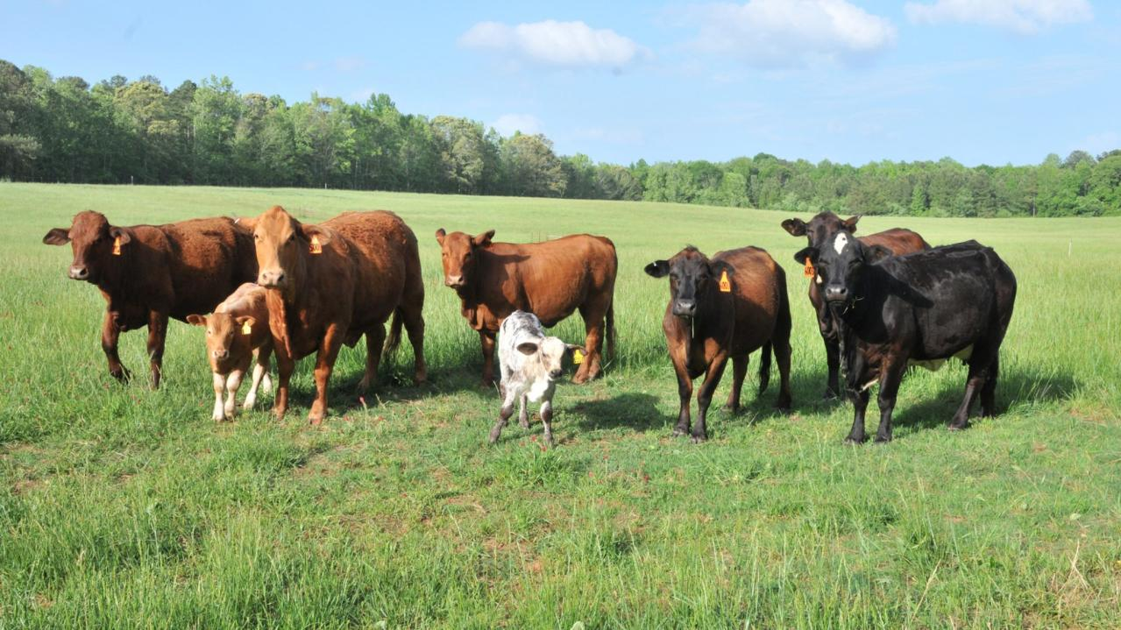
Can we achieve herd immunity?
%Immune = 1 – (1/ R0)
Notes:
% needed depends on R0
With R0 at 6.5, need 85% of population fully vaccinated
Assumes vaccination 100% effective against infection (sterilizing immunity)

Slide 5

When is it safe to open up?

Slide 6
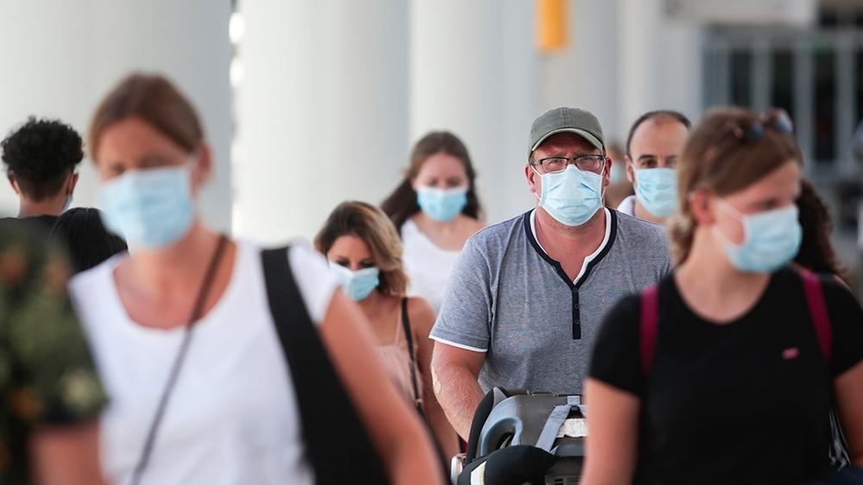
How long will we have to live with Covid?

Slide 7
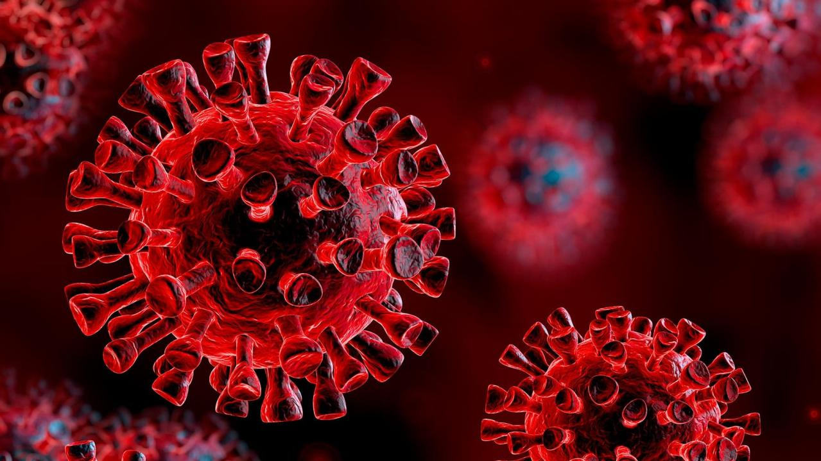
Will there be more variants?
Notes:
12 classified variants
Alpha, Beta, Gamma, Delta, Lambda, Mu, Epsilon, Zeta, Theta, Eta, Iota, Kappa
Many of these no longer VOC
24 Greek letters
88 Constellations

Slide 8
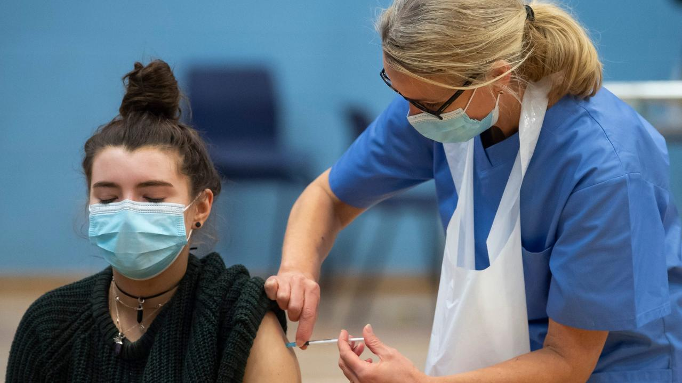
Will vaccines work against new variants?
Notes:
Yes – also vaccines now being developed against the nucleocapsid (N) protein which tends not to mutate

Slide 9
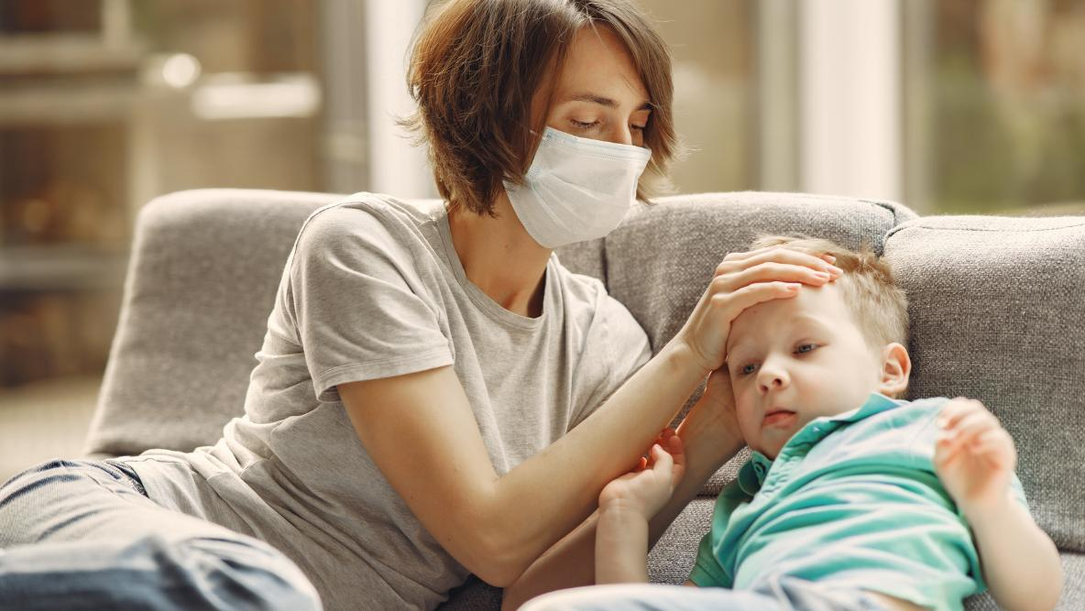
Why don’t kids get
very sick from covid?
Notes:
Kids immune system stronger
Lots of snotty noses – 4 coronaviruses cause common cold
MMR vaccine cross immunity - two doses
Diphtheria Tetanus Pertussis (DPT) also cross immunity given at 2, 4, 6, 18 m, 4-6 years, and booster at 11-12

Slide 10

How safe are children in school?
Notes:
rarely get infected

Slide 11

What is Long-Covid?
Notes:
50% of hospitalised patients have symptoms 30+ days out
19% of asymptomatic people have symptoms 30+ days out

Slide 12

Notes:
The effective reproduction number (Reff) is the average number of people each case infects. However, it is an average. We know it varies tremendously. The measure of variability is called K.

Slide 13
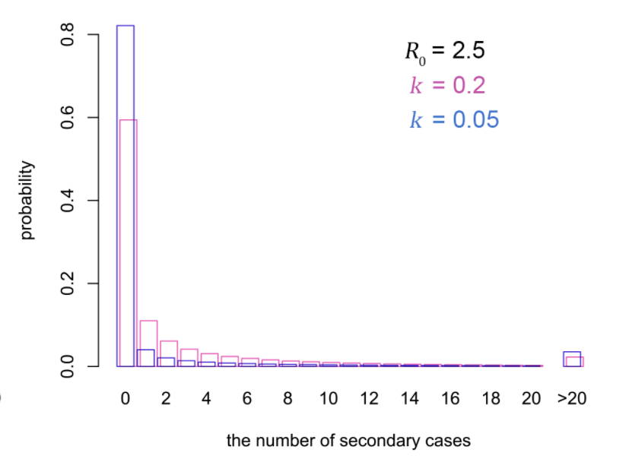
Notes:
When k is close to zero, a small number of infected people infect many others. So, looking at blue bars, with k at 0.05, 80% of infected people infect no one alse, whereas a small percentage infect more than 20 people. With k closer to 1, 60% of people infect no one else, but it is unlikely that someone will infect more than 3-4 people.
Current estimate for k is about 0.1, with 10% of cases causing 80% of infections. These are what we call the superspeaders.
Why is it important to know about this?

Slide 14

Notes:
Usually use forward tracing. Works well for high k.
With k close to 0, more efficient to do backward contact tracing.
Also gives clues to prevention

Slide 15

Notes:
Might be partly social, partly genetic
Social – likes going out to events, shopping etc.
Older
Obese
Male
Impaired immune system
So, profile is older, obese, male, impaired immune system, and very sociable

Slide 16
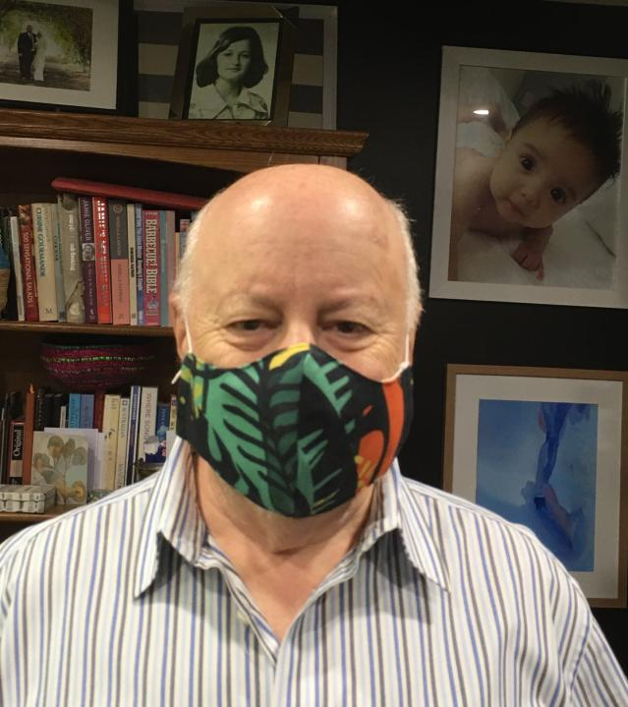
A super-spreader

Slide 17

Making UniSA
safe

Slide 18
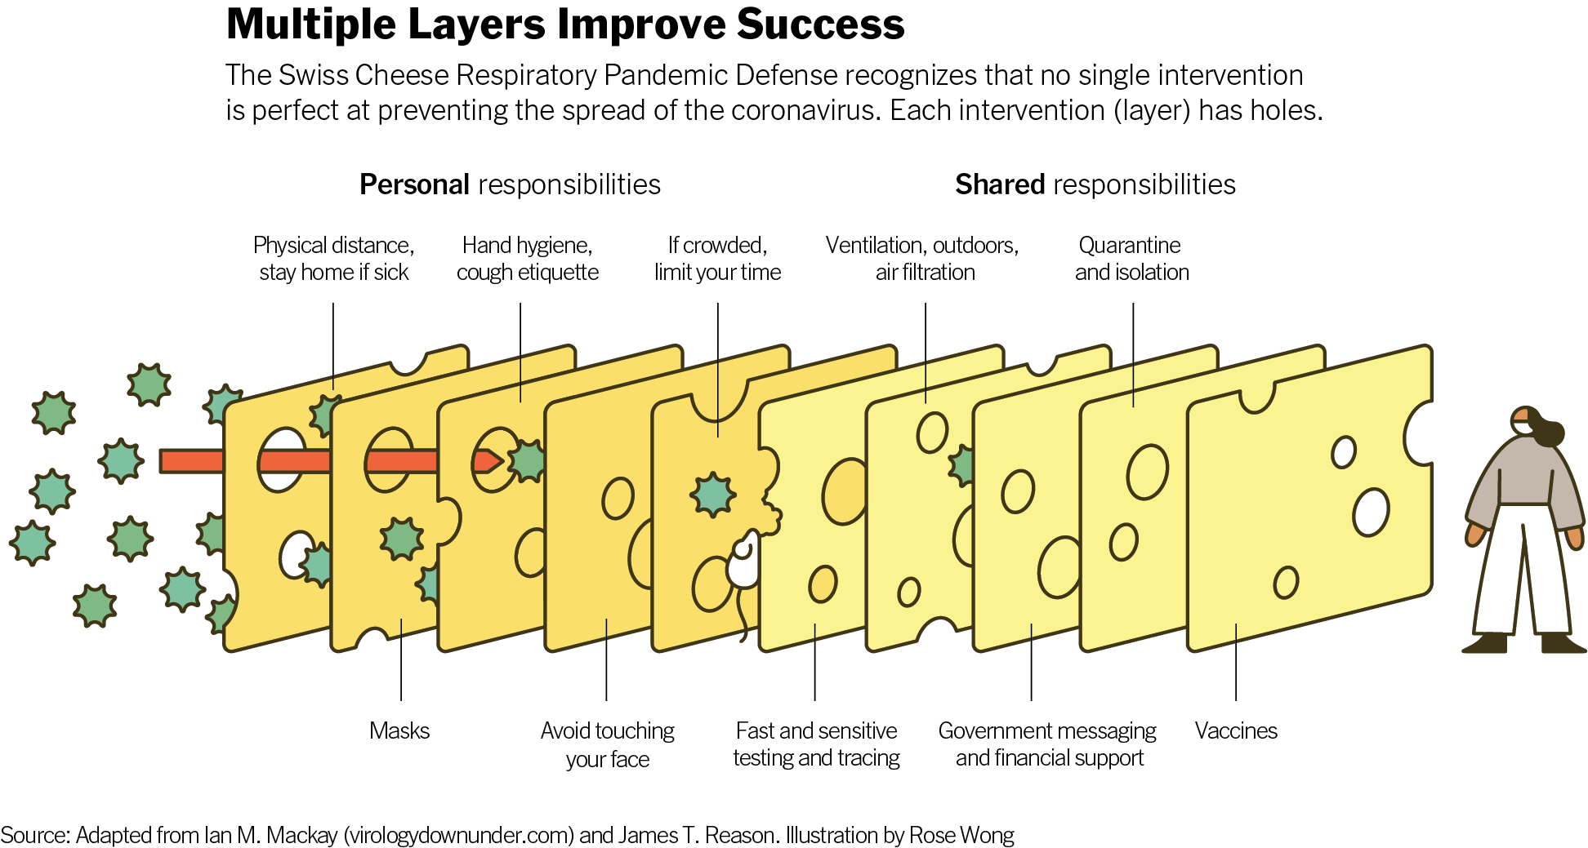

Slide 19
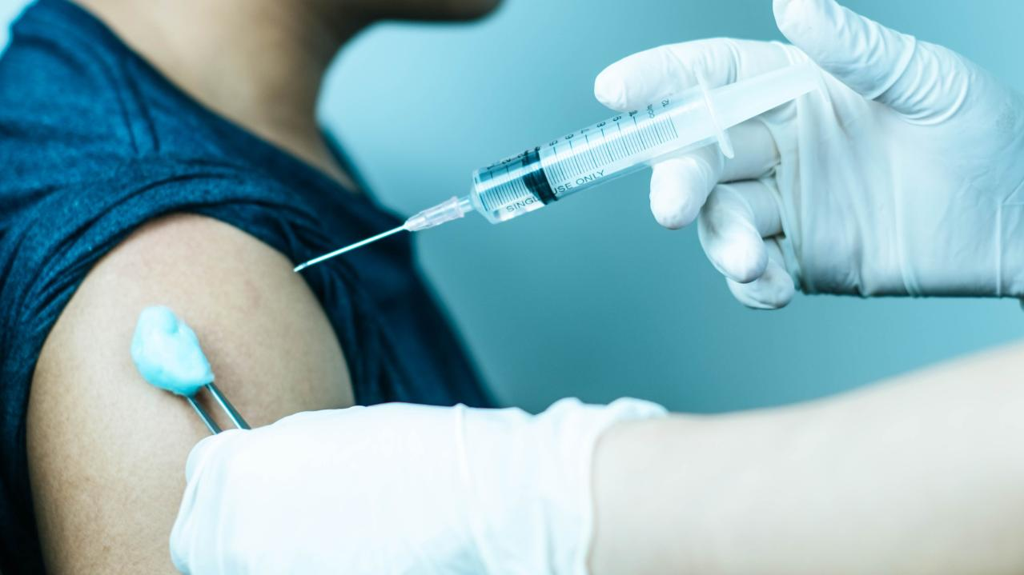
Vaccination

Slide 20

Work from home

Slide 21
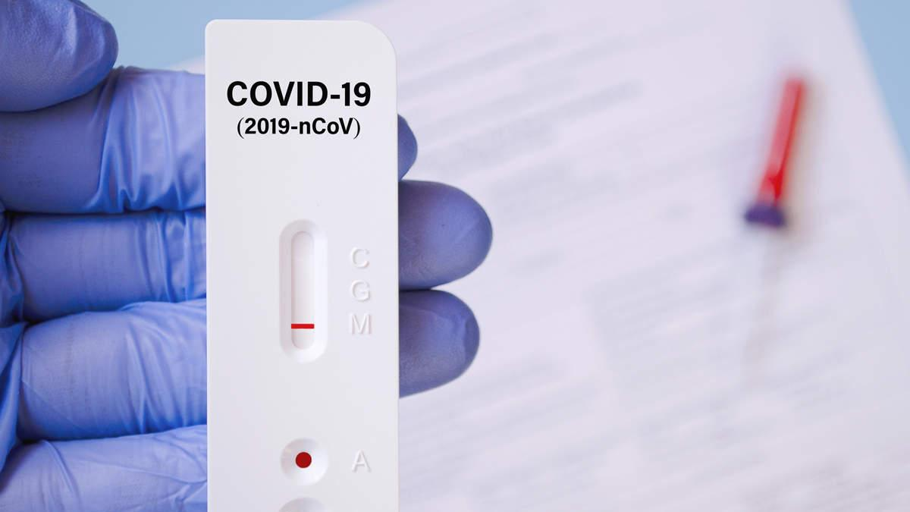
Regular testing

Slide 22

Face masks

Slide 23

Ventilation

Slide 24

Hygiene

